Slide 1


GRADE 8 ICT/DESIGN
Lesson 2: Prepare: Selecting a Focus Need
Ms. Abboud • Grade 8 - ICT/Design • Term 1, Week 4

Slide 2
Learning Objectives
WALT - We Are Learning To
WILF - What I'm Looking For
Select and justify one focus need from yesterday's categories.
Write design criteria and prepare an initial solution idea.
My focus need is specific and clearly stated.
My design criteria are measurable/checkable, not vague.

Slide 3
Academic Vocabulary
Category
Criteria
A group of related ideas or items, organized so they're easier to think about together.
The specific standards or requirements a solution needs to meet to be considered successful.

Slide 4
Frayer Model: Criteria
DEFINITION
CHARACTERISTICS
The specific standards or requirements a solution needs to meet to be considered successful.
Specific and checkable, not vague; usually follows a 'must ___ so that ___' pattern.
CRITERIA
EXAMPLES
NON-EXAMPLES
Must distribute weight across both shoulders, so it doesn't strain one side of the back.
Should be 'nice to use' - too vague to check.

Slide 5
National Identity Integration
UAE commitment to inclusive design: choosing and justifying criteria that ensure a solution truly serves its intended user group.

Slide 6
STARTER
Quick Recall
What were your group's top 2-3 categories from yesterday?
Hook • Engage & Ask
5 - 10 minutes

Slide 7
LESSON CORE
I Do: Introducing Design Criteria
Design criteria are the specific things a good solution MUST do - not vague wishes.
Pattern: 'The solution must ___ so that ___.'
Gradual Release of Responsibility
35 - 45 minutes
1 / 3

Slide 8
LESSON CORE
We Do: Review & Discuss
Groups review their categorized needs together and discuss which one to select as their focus.
Gradual Release of Responsibility
35 - 45 minutes
2 / 3

Slide 9
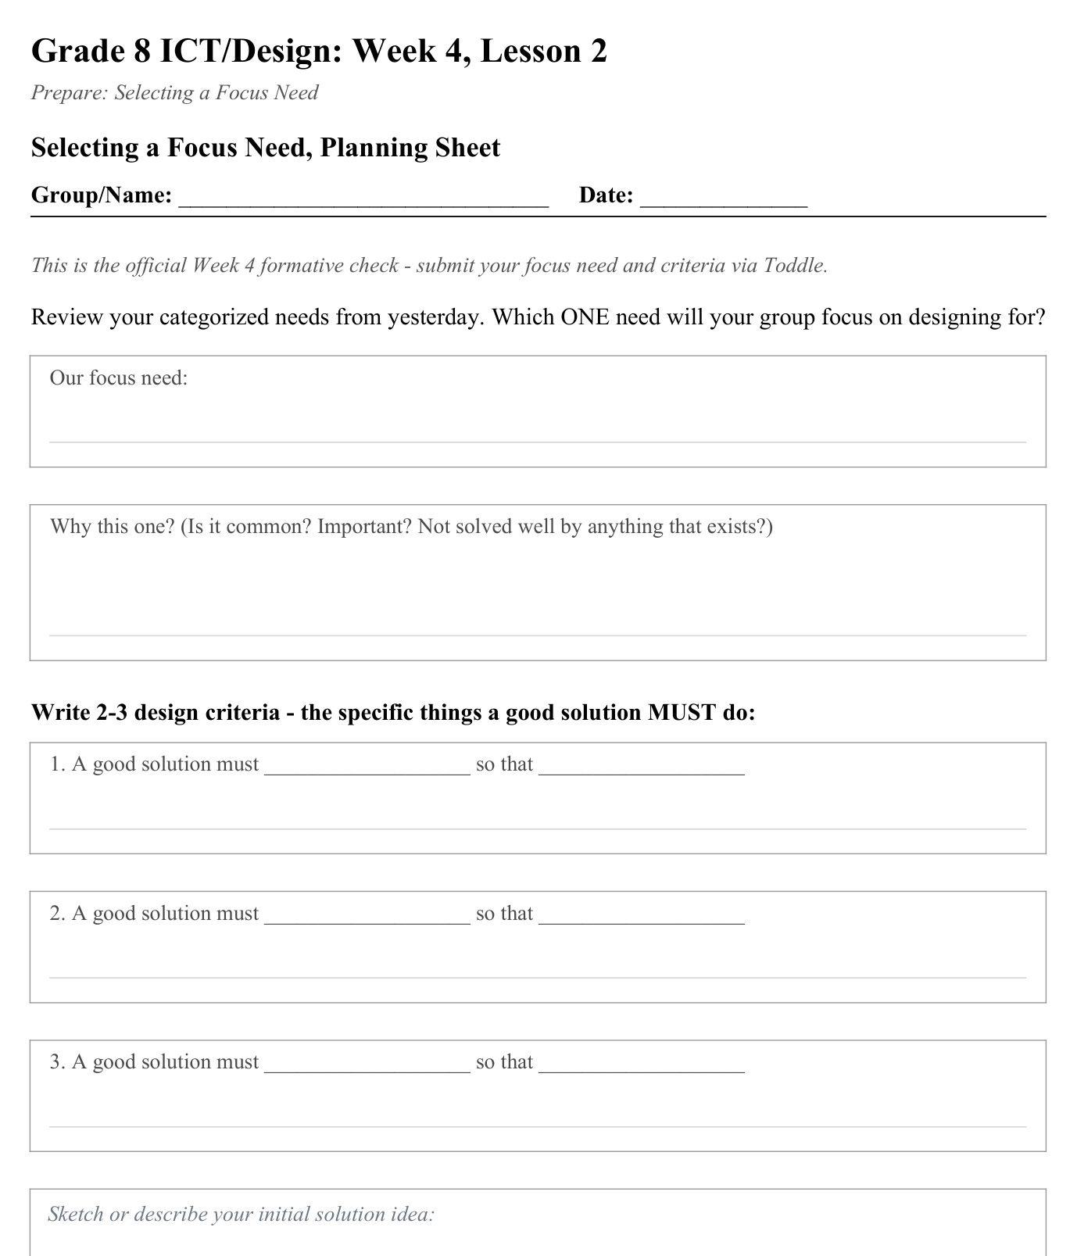
LESSON CORE
You Do: Focus, Criteria & Sketch
Select one focus need, write 2-3 design criteria, and sketch an initial solution idea.
Activity: Selecting a Focus Need, Planning Sheet
Gradual Release of Responsibility
35 - 45 minutes
3 / 3

Slide 10
CLOSURE
Formal Check
Formal Week 4 formative check: submit your focus need + criteria via Toddle.
Transition & Extend
5 - 10 minutes

